Slide 1
Module 2

Slide 2
Families of Automata
Finite Automata
FA with Output
FA without Output
DFA
Moore Machines
Mealy Machines
NFA
Є - NFA

Slide 3
Food for thought !
Can all languages be accepted by using an FA?
Is there any language that cannot have an FA?

Slide 4
Families of Languages, Machines and Grammar Noam Chomsky

Slide 5
Pushdown Automata (PDA)
Pushdown Automata is a finite automata with extra memory called stack which helps Pushdown automata to recognize Context Free Languages.
PDA = FA + memory (stack)

Slide 6
Components of a PDA

Slide 7
Formal Definition of PDA
A PDA can be formally described as a 7-tuple (Q, ∑, Γ, δ, q₀, Z₀, F)
Q is the finite number of states
∑ is input alphabet
Γ is stack symbol
δ is the transition function: Q × (∑ ∪ {ε}) × Γ × Q × Γ *
q₀ is the initial state (q₀ ∈ Q)
Z₀ is the initial stack top symbol (I ∈ Γ)
F is a set of accepting states (F ∈ Q)

Slide 8
Working of PDA

Slide 9
Instantaneous Description (ID) of a PDA
an informal notation of how a PDA “computes” a input string and make a decision that string is accepted or rejected
A ID is a triple (q, w, α), where: 1. q is the input symbol , can be empty string. 2. w is the TOS. 3.α is the content pushed onto stack + TOS , can also be empty for popping.

Slide 10
1. Construct a PDA for A={a^{n}b^{n} | n>=0}

Slide 11
2. Construct a PDA for A={a^{n}b^{m} | n>=m}

Slide 12
3. Construct a PDA for A={a^{n}b^{n}c^{m} | n,m>=1}

Slide 13
4. Construct a PDA for A={a^{n}b^{m}c^{n} | n,m>=1}

Slide 14
5. Construct a PDA for A={a^{n}b^{2n}}

Slide 15
Non Deterministic PushDown Automata(NPDA)
used to generate a language that a deterministic automata cannot generate.
more powerful than a deterministic PDA
more than one state transition can happen for a given input

Slide 16
1. Construct an NPDA for a palindrome

Slide 17
2. Construct an NPDA for L1={a^{n}b^{n} | n>=0} U L2={a^{n}b^{2n}}

Slide 18
Context Free Grammar (CFG)
Context free grammar is a formal grammar which is used to generate all possible strings in a given formal language.
G= (V, T, P, S)
A→α
A ∈ V
Α ∈ (V U T)*
Every regular grammar is context-free, but not all context-free grammars are regular.

Slide 19
Consider the grammar
E → E + E
E → E * E
E → I
I → id
Derive the string id+id*id

Slide 20
id+id*id
E → E + E
E → E * E
E → I
I → id
Left Most Derivation (LMD)
Right Most Derivation (RMD)

Slide 21
Ambiguity in Grammar
A CFG, G ={V,T,P,S} is ambiguous , if there exists at least a string W in T* , where there is
More than one LMD
More than one RMD
More than one parse tree
id + id * id
2 + 3 * 4

Slide 22
1. Construct a CFG for A={a^{n}b^{n} | n>=1}

Slide 23
2. Construct a CFG for A={a^{n}b^{2n} | n>=1}

Slide 24
3. Construct a CFG for A={ww^{T}, w ∈ {a,b}*} // Palindrome

Slide 25
4. Even Length Palindrome
5. Odd Length Palindrome

Slide 26
6. Construct a CFG for A={wcw^{T}, w ∈ {a,b}*}

Slide 27
7. Construct a CFG for A={a^{n}b^{m}c^{n} | n,m>=1}

Slide 28
8. Construct a CFG for A={a^{n}b^{m}c^{m}d^{n} | n,m>=1}

Slide 29
9. Construct a CFG for A={a^{n}b^{m}c^{n}d^{m} | n,m>=1}

Slide 30
10. Construct a CFG for A={a^{n}b^{n}c^{m}d^{m} | n,m>=1}

Slide 31
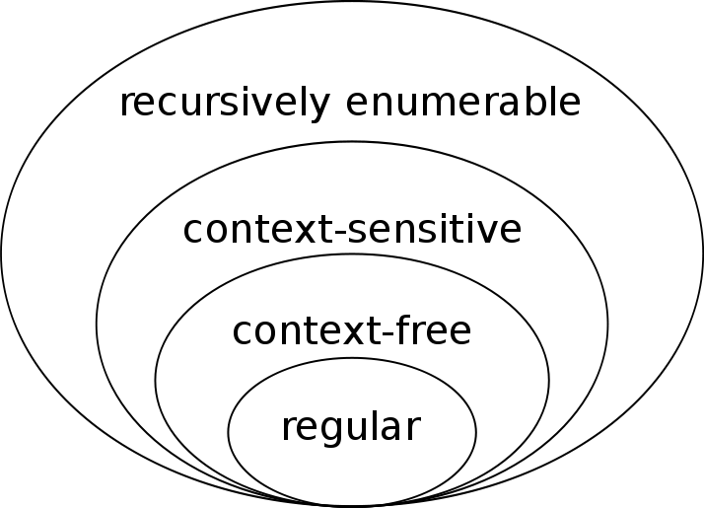
Context Free Language
A context-free language (CFL) is a language generated by a context-free grammar (CFG – type 2) and accepted by pushdown automata
All regular languages are context-free languages, but not all context-free languages are regular

Slide 32
Properties of CFL
Closure Properties
Non- Closure Properties

Slide 33
Closure Properties of CFL
Context-free languages are closed under −
Union - Let L₁ and L₂ be two context free languages. Then L₁ ∪ L₂ is also context free.
Concatenation - If L₁ and L₂ are context free languages, then L₁L₂ is also context free.
Kleene Star operation - If L is a context free language, then L* is also context free

Slide 34
Non – Closure Properties of CFL
Context-free languages are not closed under −
Intersection − If L1 and L2 are context free languages, then L1 ∩ L2 is not necessarily context free.
Intersection with Regular Language − If L1 is a regular language and L2 is a context free language, then L1 ∩ L2 is a context free language.
Complement − If L1 is a context free language, then L1’ may not be context free.

Slide 35
Chomsky Normal Form (CNF)
A CFG(context free grammar) is in CNF if all production rules satisfy one of the following conditions:
Start symbol generating ε. For example, A → ε.
A non-terminal generating two non-terminals. For example, S → AB.
A non-terminal generating a terminal. For example, S → a.
G1 = {S → AB
S → c
A → a
B → b}
G2 = {S → aA
A → a
B → c}

Slide 36
Conversion of CFG to CNF
If the start symbol S occurs on some right side, create a new start symbol S’ and a new production S’→ S.
Remove
Null productions.
Unit productions.
Useless productions
Eliminate terminals from the RHS of the production if they exist with other non-terminals/terminals
Eliminate RHS with more than two non-terminals.

Slide 37
1. Convert the CFG to CNF
S → aA
A → a
B → c

Slide 38
2. Convert the CFG to CNF
S → a | aA | B
A → aBB | ε
B → Aa | b

Slide 39
Greibach Normal Form (GNF)
A CFG is in GNF if all the production rules satisfy one of the following conditions:
A start symbol generating ε. For example, S → ε.
A non-terminal generating a terminal. For example, A → a.
A non-terminal generating a terminal which is followed by any number of non-terminals. For example, S → aASB.
G1 = { S → aAB | aB
A → aA| a
B → bB | b }
G2 = { S → aAB | aB
A → aA | ε
B → bB | ε }

Slide 40
Conversion of CFG to GNF
Convert the grammar into CNF.
If the grammar has left recursion, eliminate it .
Convert into GNF.

Slide 41
1. Convert the CFG to GNF
S → XB | AA
A → a | SA
B → b
X → a

Slide 42
2. Convert the CFG to GNF
S → XY | Xn |p
X → mX | m
Y → Xn | o

Slide 43
3. Convert the CFG to GNF
S → XA | BB
B → b | SB
X → b
A → a

Slide 44
Equivalence of CFG and PDA

Slide 45
1. Find the equivalent PDA for the CFG
S → aSa
S → bSb
S → c
State | Unread Input | TOS | Transition No:

Slide 46
2. Find the equivalent PDA for the CFG
S → 0SX | 1SY | ε
X → 1
Y → 0

Slide 47
3. Find the equivalent PDA for the CFG
S → 0BB
B → 0S | 1S |0

Slide 48
4. Find the equivalent PDA for the CFG
S → aSB
S → a | b | ε

